Slide 1
GROUP B
TEST FOR NORMALITY
Adebowale Oluwasanmi
Miguel Angel Acuña Silva

Slide 2
Objectives
To determine :
What are the characteristics of a piece of real estate that has the most influence on price?.
Do the relevant variables follow a normal distribution?.
Correlation between relevant variables.

Slide 3
Sampling method
We used random sampling technique in SPSS to get the
sample size (approx. 10% of the entire population).
Sample size ( N = 2,105).

Slide 4
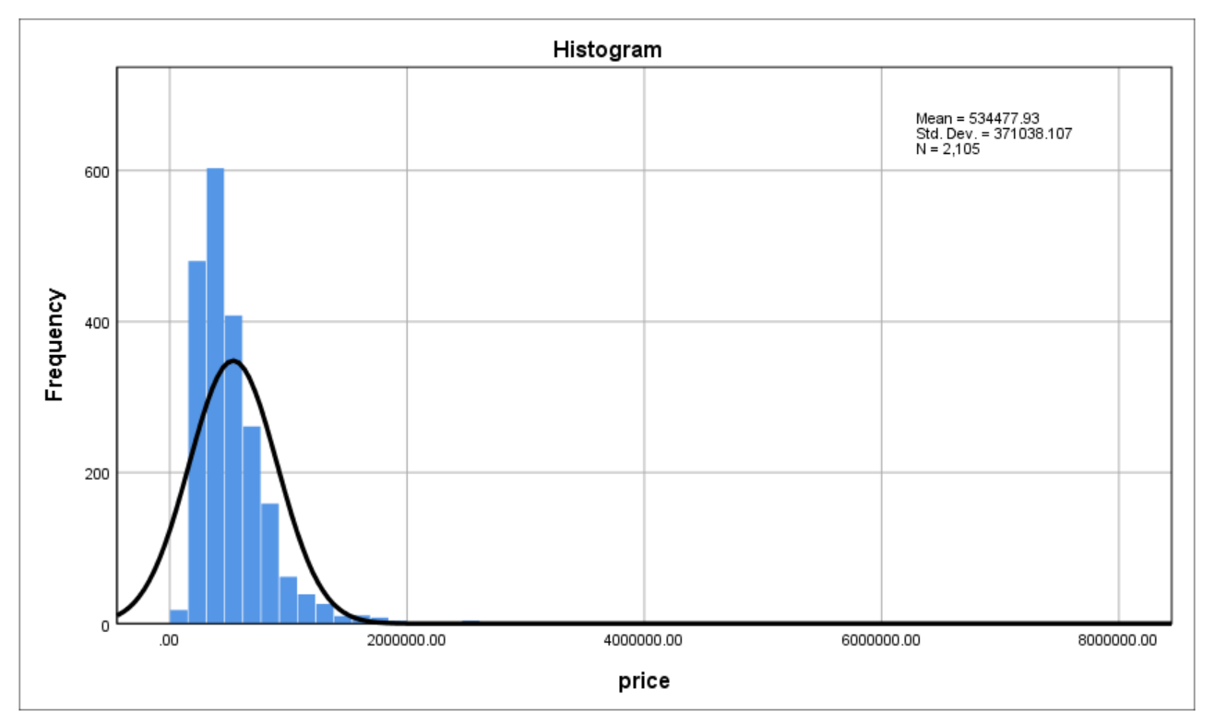
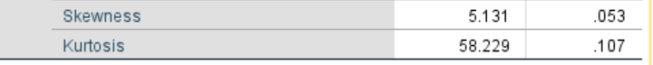

INTRODUCTION
According to Burinskiene, Rutzkiene and Venckauskaite (2011), important factors that have influence on price are location, prestige, age of building and if it was renovated or not.
We will be testing some of the parameters formerly mentioned, including price for normality. We’ll be also including the sq. footage of the house, to be able to compare with a variable outside the suggested ones.
NULL HYPOTHESIS (Ho) – The value for prices are normally distributed within the population.
1. PRICE (Normality tests)
Histogram showing price distribution.
Table showing Statistics and Std. error
The z-value for both
skewness and kurtosis
exceed the $±$1.96 threshold.
The z-values also confirm that the distribution has positive skewness and positive kurtosis.
Z value (Skewness)
= 5.131/0.053
= 96.8
Z value (Kurtosis)
= 58.229/0.107
= 544.19

Slide 5
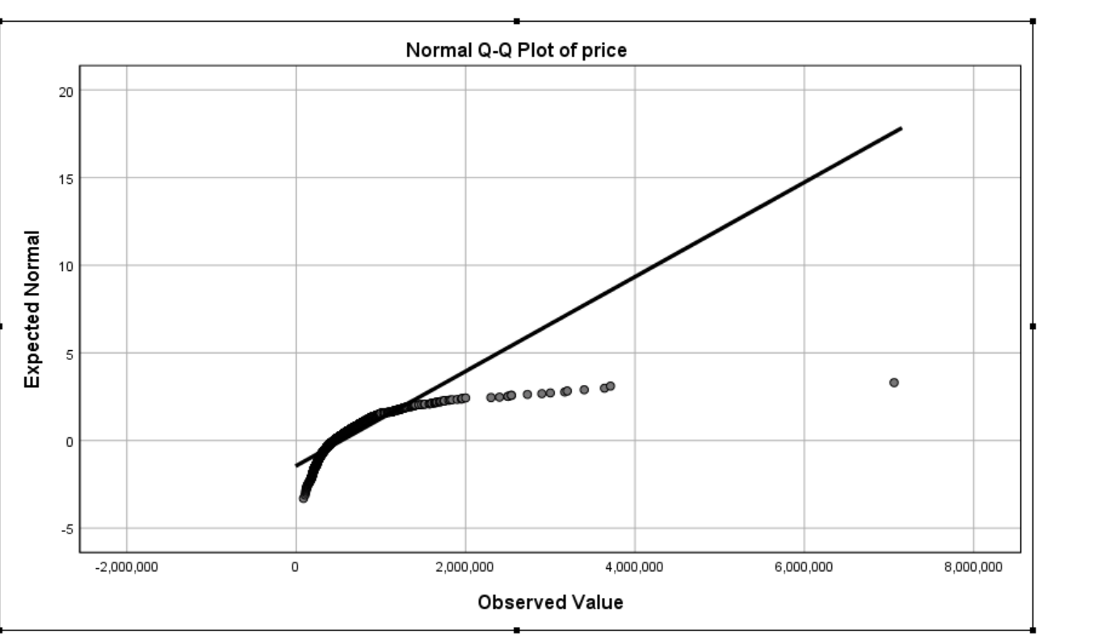
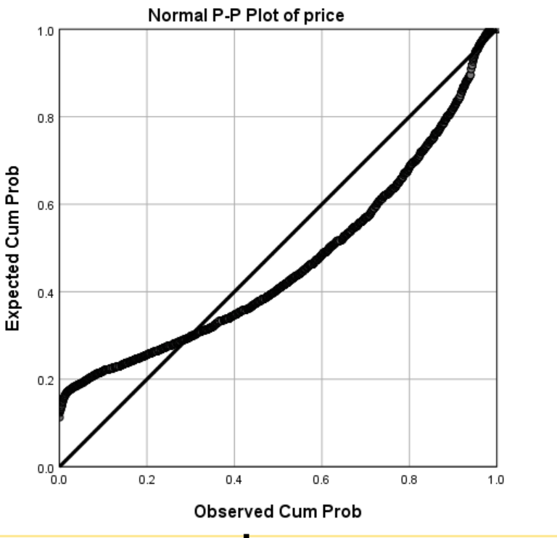
Findings
The results and observations above show that the distribution is rightly skewed , this is because extreme values of prices in the tail affect the mean more than the median.
Results also show that the distribution is highly kurtotic (positive kurtosis), which indicates the presence of a lot of outliers.
Q-Q plot show a significant departure of price values from normality at the tails.
P-P plot show a significant departure of price values from normality at the centre.

Slide 6
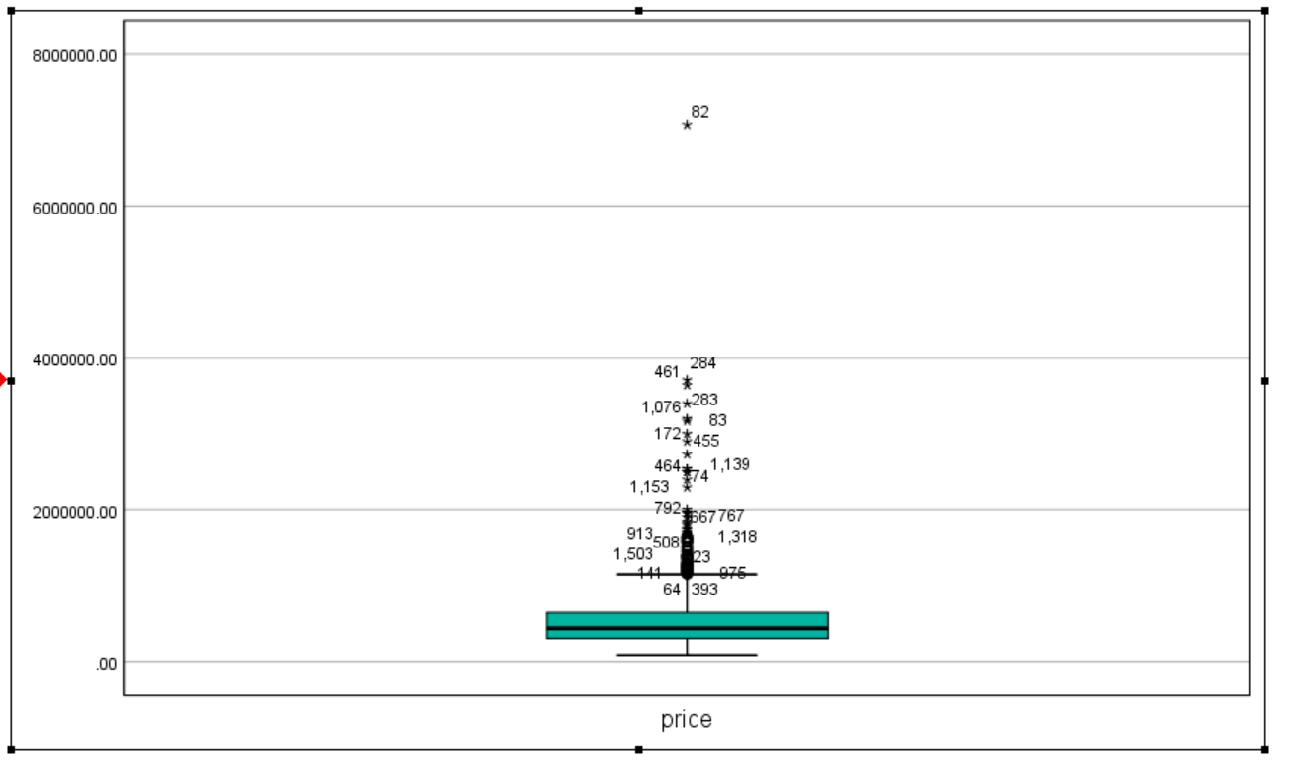
BOX PLOT (PRICE)
Box plot show that the tail is longer on the right, which confirms that the distribution has
a positive skew.

Slide 7
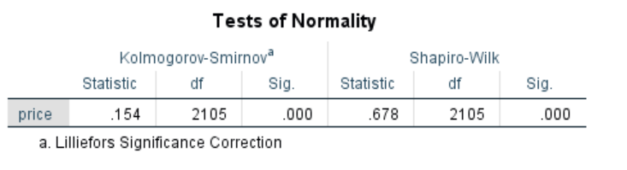
STATISTICAL TESTS (PRICE)
Shapiro-Wilk & Kolmogorov-Smirnov tests
As shown above, both the Shapiro-Wilk and Kolmogorov-Smirnov tests agree that price violates the assumption of normality with P<0.05 for both tests.

Slide 8
CONCLUSION
Visual inspection of the histogram, normal Q-Q plots, P-P plots, box plots and statistical tests such as the Shapiro-Wilk & Kolmorov-Smirnov tests showed that the prices were not normally distributed, with a skewness of 5.131 (SE= 0.053) and kurtosis of 58.229 (SE= 0.107).
In conclusion, we reject the null hypothesis.

Slide 9
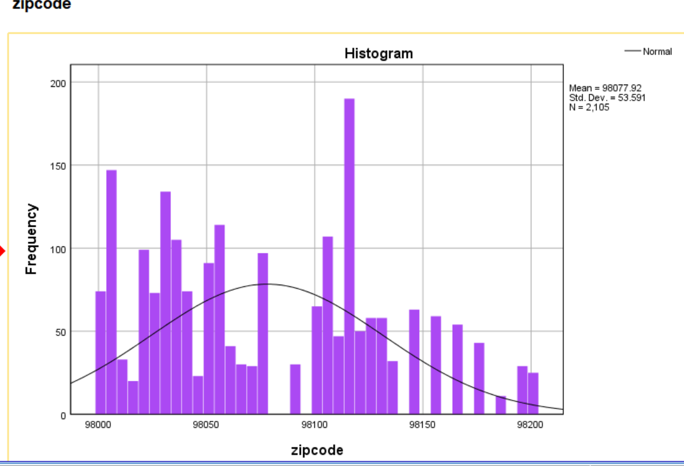
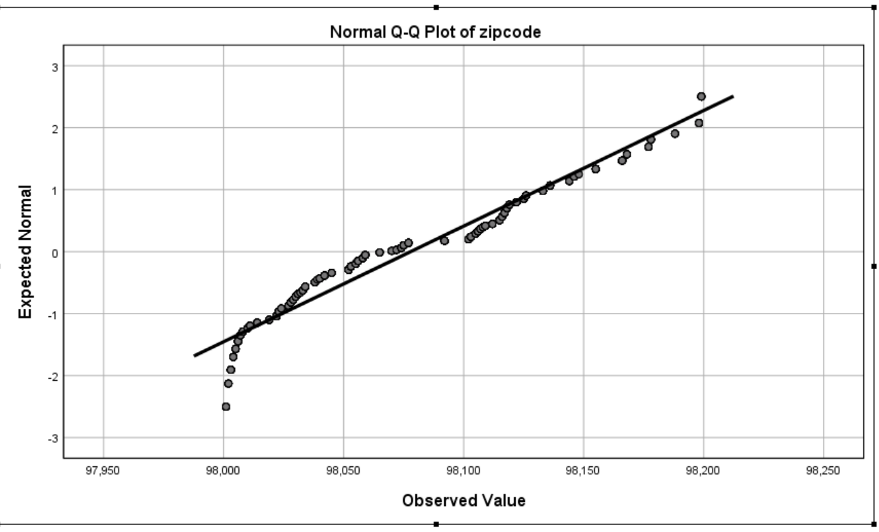
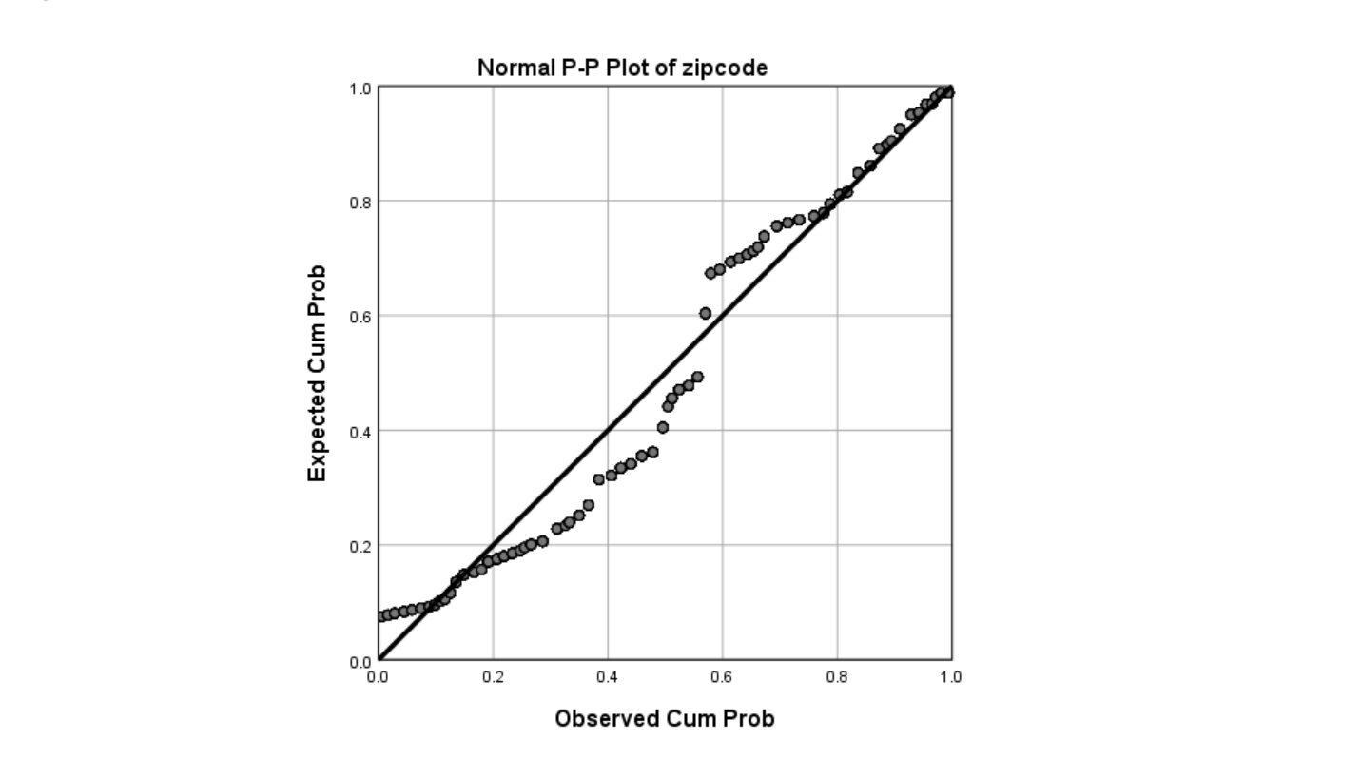
2) ZIPCODE (Location)
NULL HYPOTHESIS (Ho) – The values for zip code follow a normal distribution.
VISUAL TESTS FOR NORMALITY
Histogram showing zip code distribution
Q-Q plot for zip code
P-P plot for zip code

Slide 10
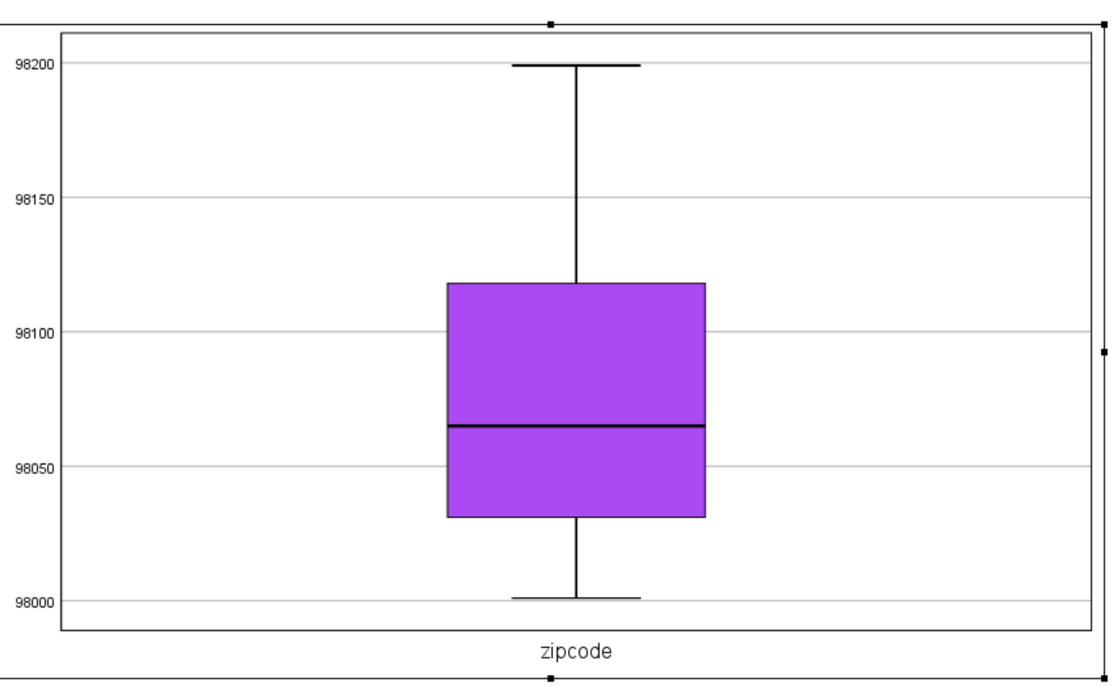
VISUAL TESTS FOR NORMALITY (CONT’D)
Box Plot showing zip code distribution
FINDINGS
The histogram reveal that the zip code distribution is slightly skewed to the right.
Q-Q plots shows a slight departure from normality at the tails of the distribution.
P-P plot shows significant departure from normality at the centre of the distribution.
The longer tail to the right on the box plot visual confirms that the distribution for zip code values is rightly skewed.

Slide 11
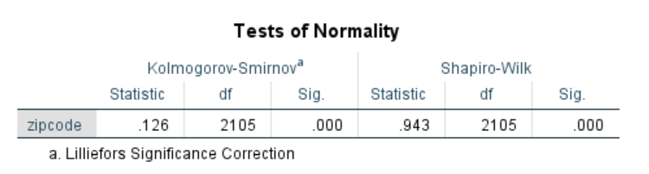

Shapiro-Wilk & Kolmorov - Smirnov tests
STATISTICAL TESTS (ZIPCODE)
The Shapiro-Wilk and Kolmogorov-Smirnov tests confirm that zip code violates the assumption of normality
with P<0.05 for both
tests.
Z Value (Skewness & Kurtosis)
The z-value for
skewness confirms that
the zip code distribution
is positively skewed,
with 6.94 exceeding $±$1.96.
While the z-value for
kurtosis falls between
the threshold of $±$1.96.
Z value (Skewness)
= 0.368/0.053
= 6.94
Z value (Kurtosis)
= 0.919/0.107
= -0.81

Slide 12
CONCLUSION
Visual tests i.e histogram, normal Q-Q plots, P-P plots, box plots and statistical tests such as the Shapiro-Wilk & Kolmorov-Smirnov tests showed that values for zip code were not normally distributed, with a skewness of 0.368 (SE= 0.053) and kurtosis of -0.919 (SE= 0.107).
Therefore, we reject the null hypothesis.

Slide 13
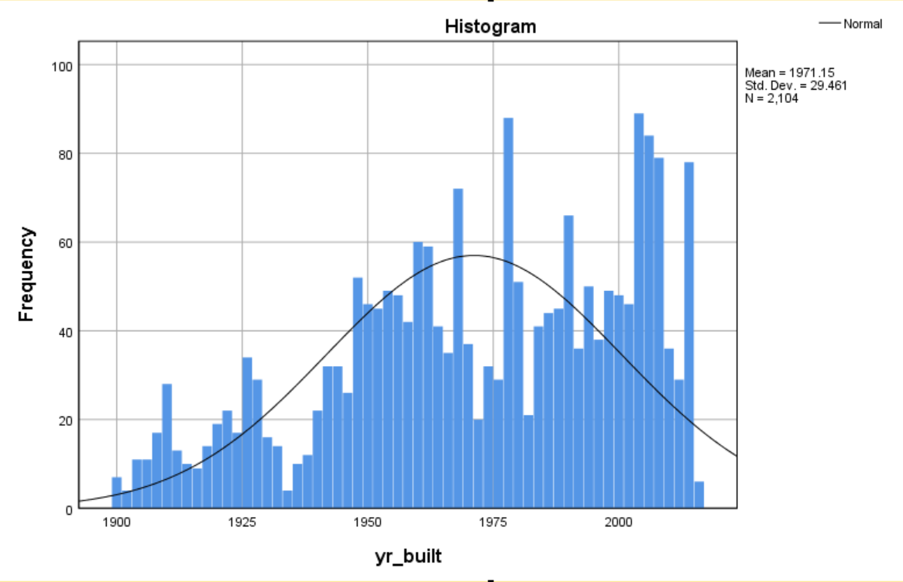
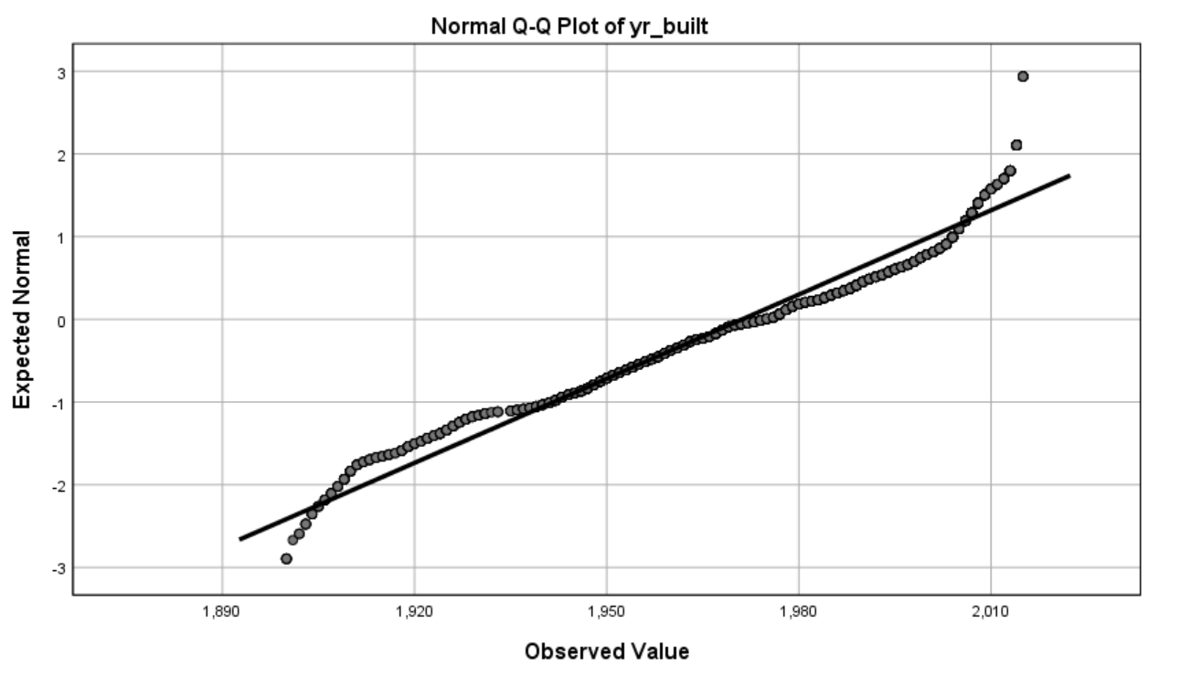
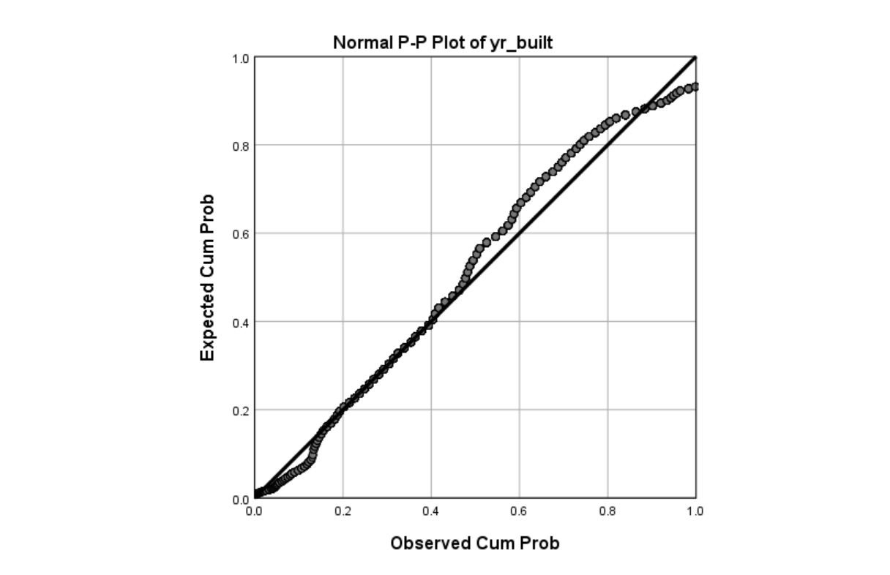
NULL HYPOTHESIS (Ho) – The values for year-built variable follow a normal distribution.
3) YEAR BUILT
VISUAL TESTS
Histogram showing year-built distribution
Q-Q plot for year-built
P-P plot for year-built

Slide 14
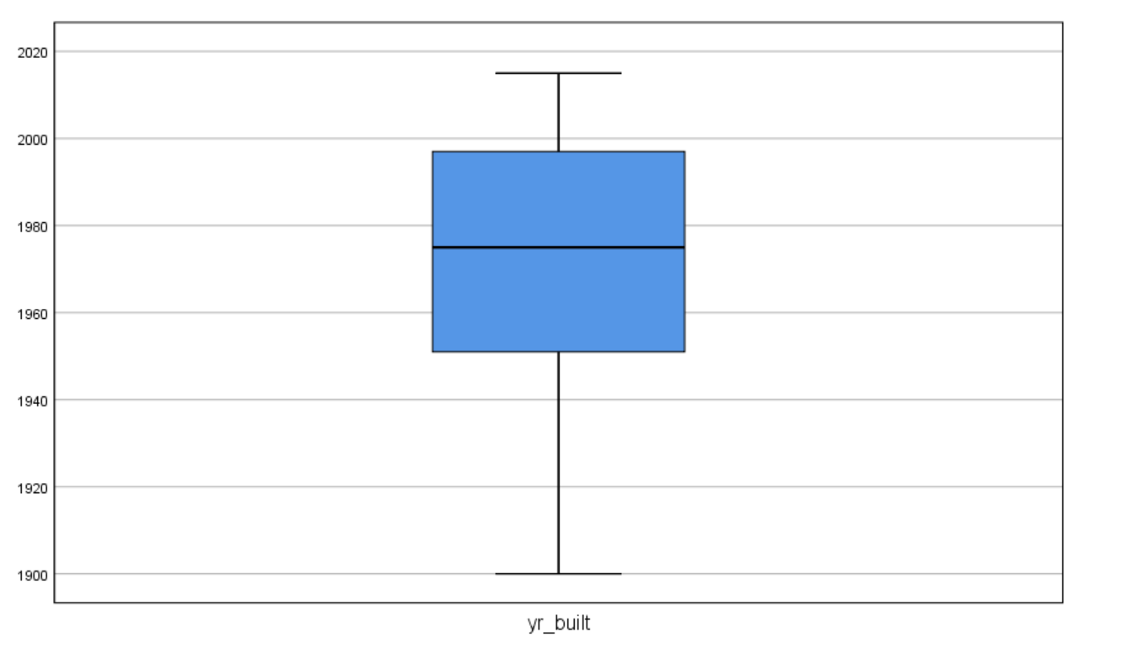
VISUAL TESTS (CONT’D)
Box Plot showing year-built distribution
FINDINGS
The histogram reveal that the year-built distribution is significantly skewed to the left,
Q-Q plots shows a slight departure from normality at the tails of the distribution.
P-P plot shows significant departure from normality at the centre of the distribution.
The longer tail to the left on the box plot visual confirms that the distribution for year-built values is left skewed.

Slide 15
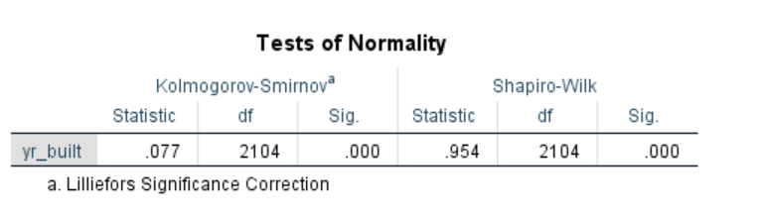
Shapiro-Wilk & Kolmorov - Smirnov tests
STATISTICAL TESTS (YEAR BUILT)
The Shapiro-Wilk and Kolmogorov-Smirnov tests confirm that year-built distribution violates the assumption of normality
with P<0.05 for both
tests.
Z Value (Skewness & Kurtosis)
The z-value for
skewness confirms that
the year-built distribution
is negatively skewed,
with -8.4 exceeding1.96.
The z-value for kurtosis
-6.53,also exceeds
the threshold of 1.96.
Z value (Skewness)
= -0.450/0.053
= -8.4
Z value (Kurtosis)
= -0.699/0.107
= -6.53

Slide 16
Conclusion
Visual tests i.e., histogram, normal Q-Q plots, P-P plots, box plots and statistical tests such as the Shapiro-Wilk & Kolmorov-Smirnov tests showed that values for year built were not normally distributed, with a skewness of -0.450 (SE= 0.053) and kurtosis of -0.699 (SE= 0.107).
We reject the null hypothesis.

Slide 17
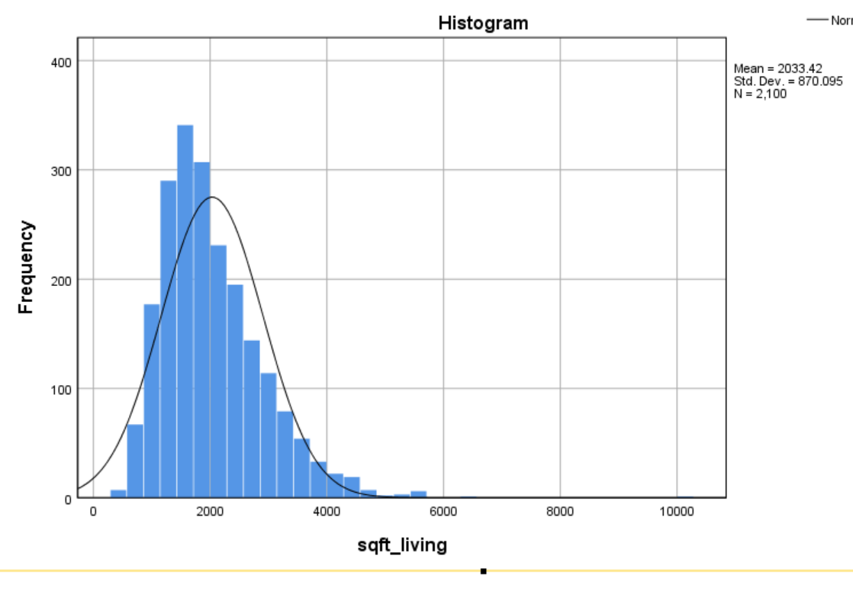
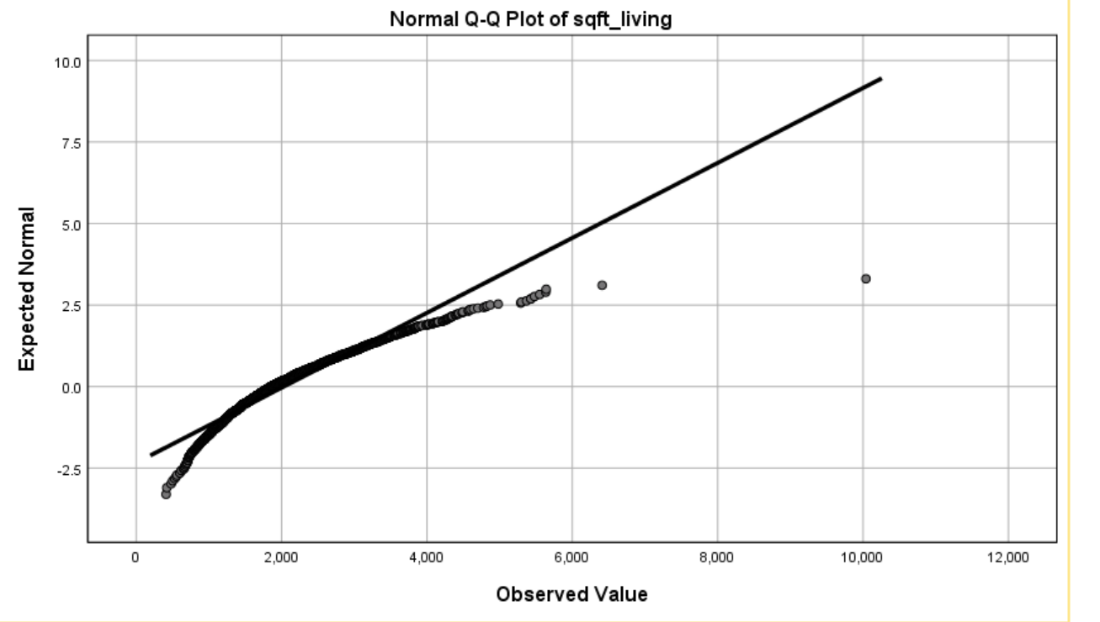
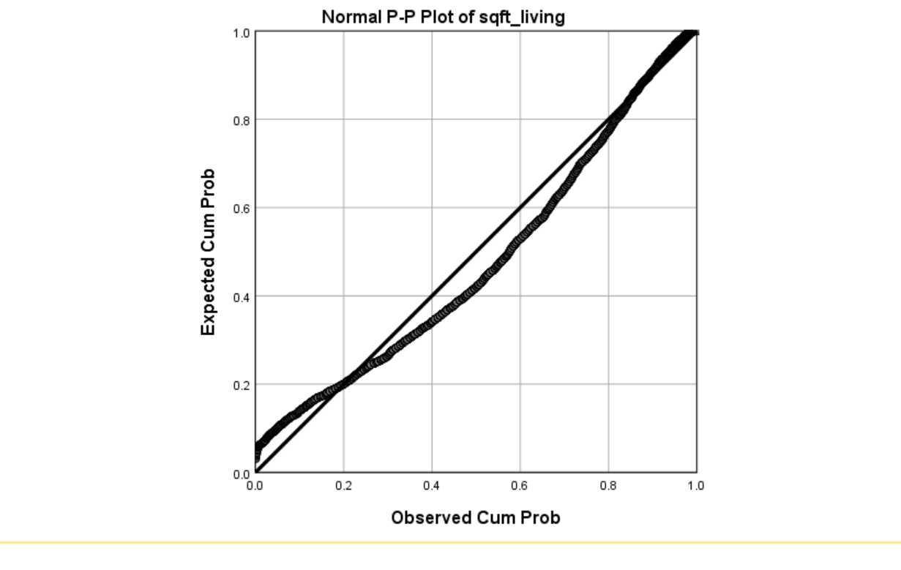
4) SQ. FT LIVING (SQ. FOOTAGE OF THE HOUSE)
NULL HYPOTHESIS (Ho) – The values for square footage of the home variable follow a normal distribution.
VISUAL TESTS
Histogram showing sq. ft distribution
Q-Q plot for sq. ft living
P-P plot for sq. ft living

Slide 18
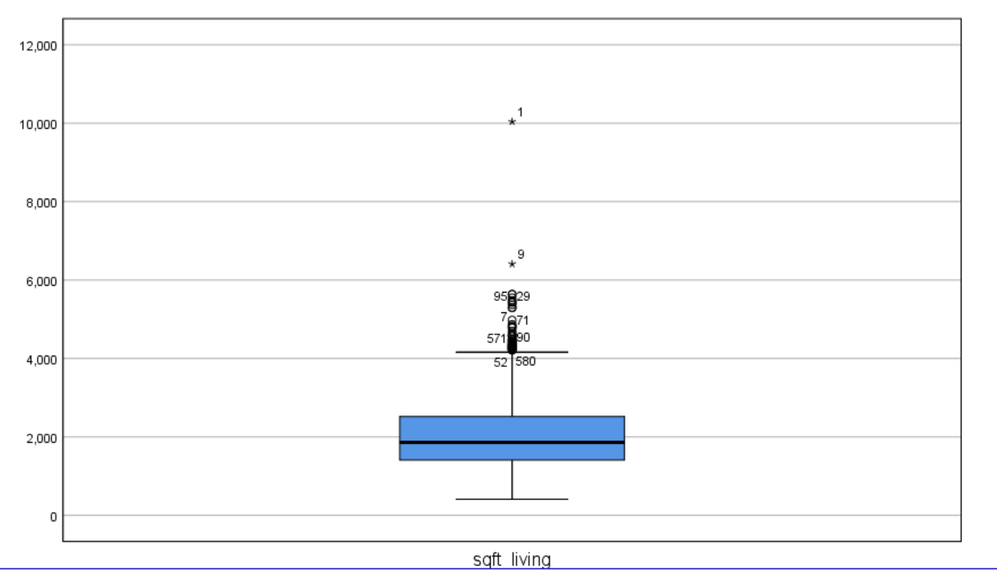
VISUAL TESTS (CONT’D)
Box Plot showing sq. ft living distribution
FINDINGS
The histogram reveal that the sq. ft living distribution is significantly skewed to the right,
Q-Q plots shows a very significant departure from normality.
P-P plot shows very significant departure from normality.
The longer tail to the right of the boxplot confirms the sq. ft living variable is rightly skewed, with many outliers.

Slide 19
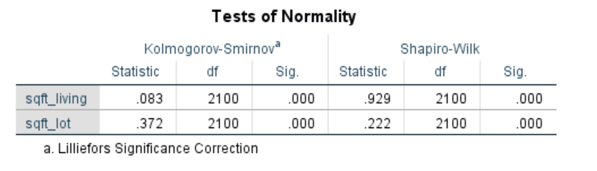
Shapiro-Wilk & Kolmorov - Smirnov tests
STATISTICAL TESTS (Sq. ft living)
The Shapiro-Wilk and Kolmogorov-Smirnov tests both indicate a p-value of less than 0.05, small enough to reject the null hypothesis that the sq. ft living variable is normally distributed.
Z Value (Skewness & Kurtosis)
Z value (Skewness)
= 1.290/0.053
= 24.3
Z value (Kurtosis)
= 4.317/0.107
= 40.3

Slide 20
Conclusion
Visual tests such as histogram, normal Q-Q plots, P-P plots, box plots and statistical tests such as the Shapiro-Wilk & Kolmogrov-Smirnov tests showed that values for sq. ft living variable were not normally distributed, with a skewness of 1.290 (SE= 0.053) and kurtosis of 4.317 (SE= 0.107).
We reject the null hypothesis.
All relevant variables to our objective violated the assumption of normality test. Therefore, non-parametric tests would be best suited for further analysis.

Slide 21
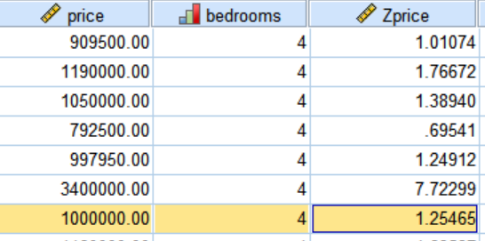
Probability ( Calculating Z-Scores)
QUESTIONS
What is the probability of 4-bedroom houses, that cost more than 1,000,000?.
2) What is the probability of houses without a waterfront, measuring less than 4,980 sq. ft living?.
3) What is the probability of houses in excellent condition, that was built before 1992?.
ANSWERS
P (x=1,000,000)
P (z=1.25) = 0.894 * 100
= 89.4 %
P (x>1,000,000) = P (z>1.25)
= 100-89.4
= 10.6%
There is a 10.6% chance that 4-bedroom houses will cost more than 1,000,000.

Slide 22
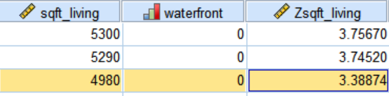
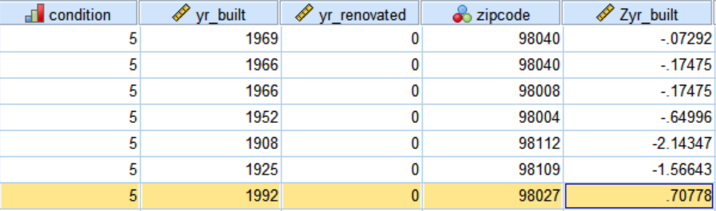
Probability ( Calculating Z-Scores)
2)
P (x=4980)
P (z=3.39) = 0.999 * 100
P (x<4980) = 99.9%
There is a 99.9% chance that houses without a waterfront will measure less than 4980 sq. ft
3)
P (x=1992)
P (z=0.70) = 0.758 * 100
P (x<1992) = 75.8%
There is 75.8% chance that houses built before 1992 are in excellent condition.

Slide 23
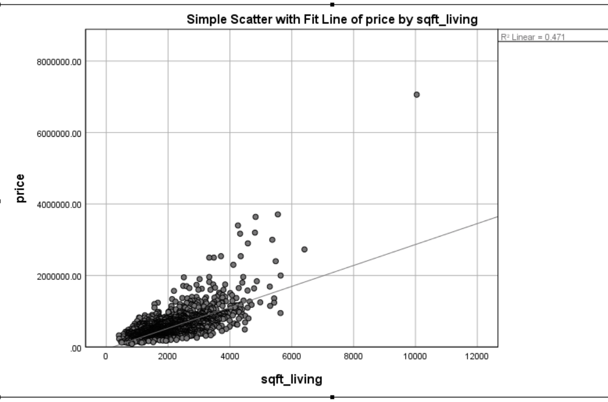
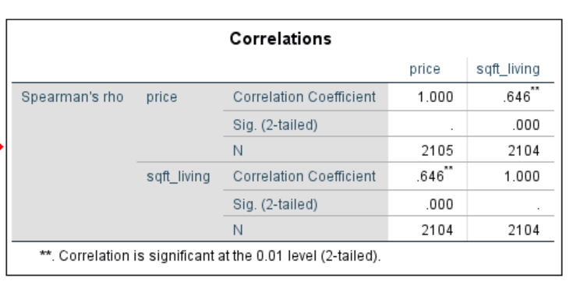
Correlation (Scatter Plot)
1)
Since the price and the sq. ft living variables seem to behave similarly, is there any correlation?
To investigate if the sq. footage of the house and price variables are related, we chose a scatterplot.
Spearman’s r = 0.646, which is a fairly strong correlation i.e., 64.6% of the variance in price can be explained by sq. footage of the house.
We can conclude that increase in sq. footage of houses may result in corresponding increase in prices.

Slide 24
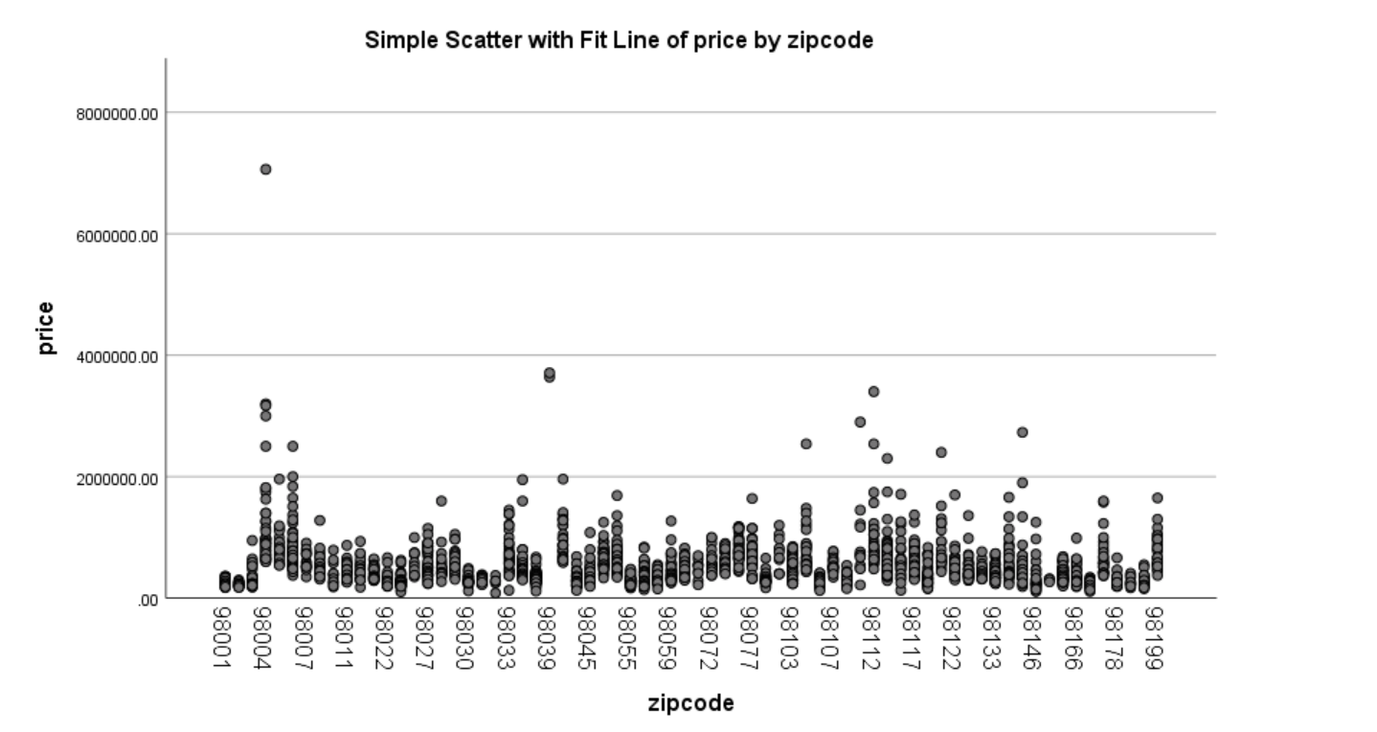
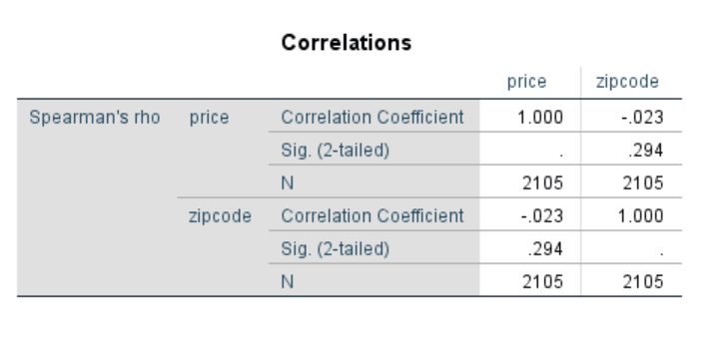
Correlation (Scatter Plot)
2)
We also investigated correlations between price and zip code.
Spearman’s r = - 0.23
Both visual and correlation analysis confirm that there is no correlation between price and zip code.

Slide 25
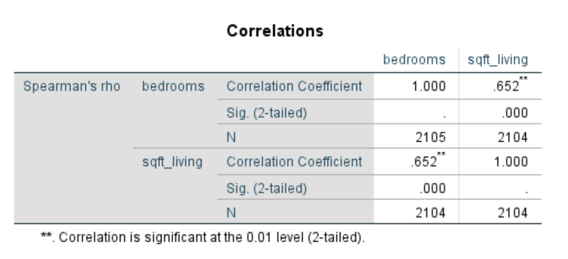
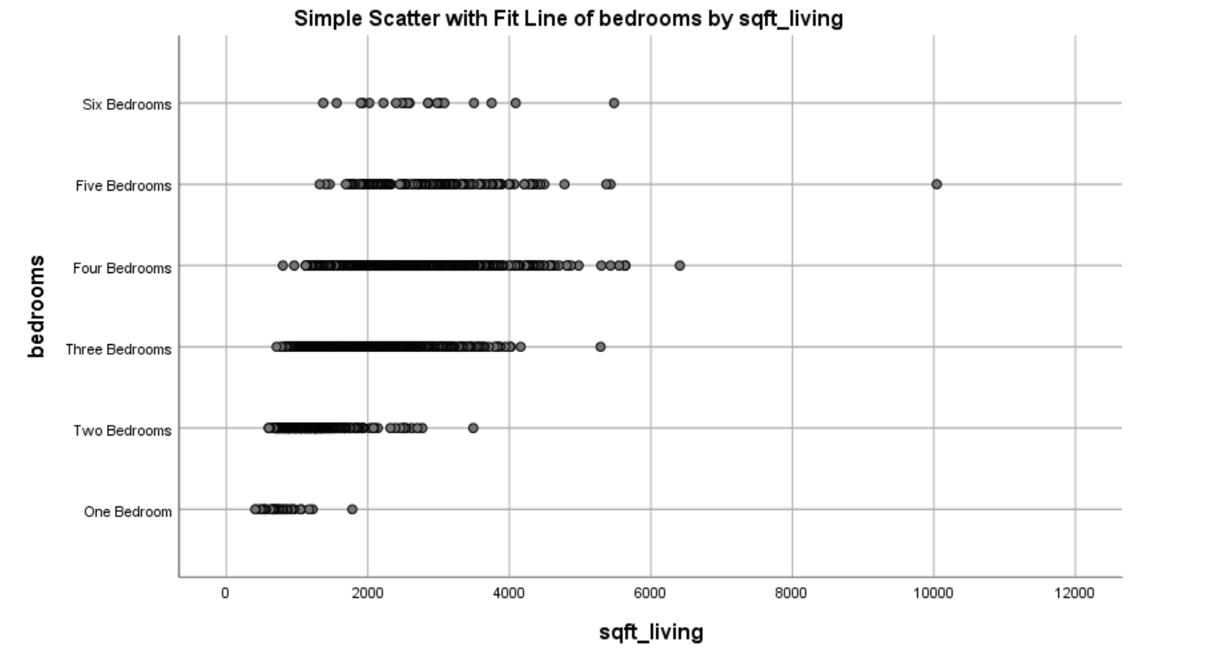
Correlation (Scatter Plot)
3)
Correlation between bedrooms and sq. ft living area
Spearman’s r = 0.652, which is a fairly strong correlation i.e., 65.2% of the variance in sq. ft living area can be explained by the bedrooms.
We can conclude that increase in the number of bedrooms may result in corresponding increase in sq. ft living area of houses.

Slide 26
References
Marija Buriskiene, Vitalija Rutzkiene and Jurate Venckauskaite (2011). Models of factors influencing real state price. Environmental engineering. p. 873-878.

Slide 27
Thank you

